Slide 1
Choosing Connectors
Software Architecture
Lecture 8

Slide 2
Role and Challenge of Software Connectors
How do we enable
components A and B to interact?
Attach adapter to A
Separate B’s “essence”
from its packaging
or B
Introduce
intermediate form
B
A
B
A
Provide B with
import/export converter
Publish abstraction
of A’s form
Transform on the fly
Maintain multiple
versions of A
Negotiate to find
common form for A and B
What is the right answer?
Make B multilingual
Change A’s form to B’s form

Slide 3
How Does One Select a Connector?
Determine a system’s interconnection and interaction needs
  Software interconnection models can help
Determine roles to be fulfilled by the system’s connectors
  Communication, coordination, conversion, facilitation
For each connector
  Determine its appropriate type(s)
  Determine its dimensions of interest
  Select appropriate values for each dimension
For multi-type, i.e., composite connectors
  Determine the atomic connector compatibilities

Slide 4
Simple Example
System components will execute in two processes on the same host
  Mostly intra-process
  Occasionally inter-process
The interaction among the components is synchronous
The components are primarily computation-intensive
  There are some data storage needs, but those are secondary

Slide 5
Simple Example (cont’d)
Select procedure call connectors for intra-process interaction
Combine procedure call connectors with distributor connectors for inter-process interaction
  RPC
Select the values for the different connector dimensions
  What are the appropriate values?
  What values are imposed by your favorite programming language(s)?

Slide 6
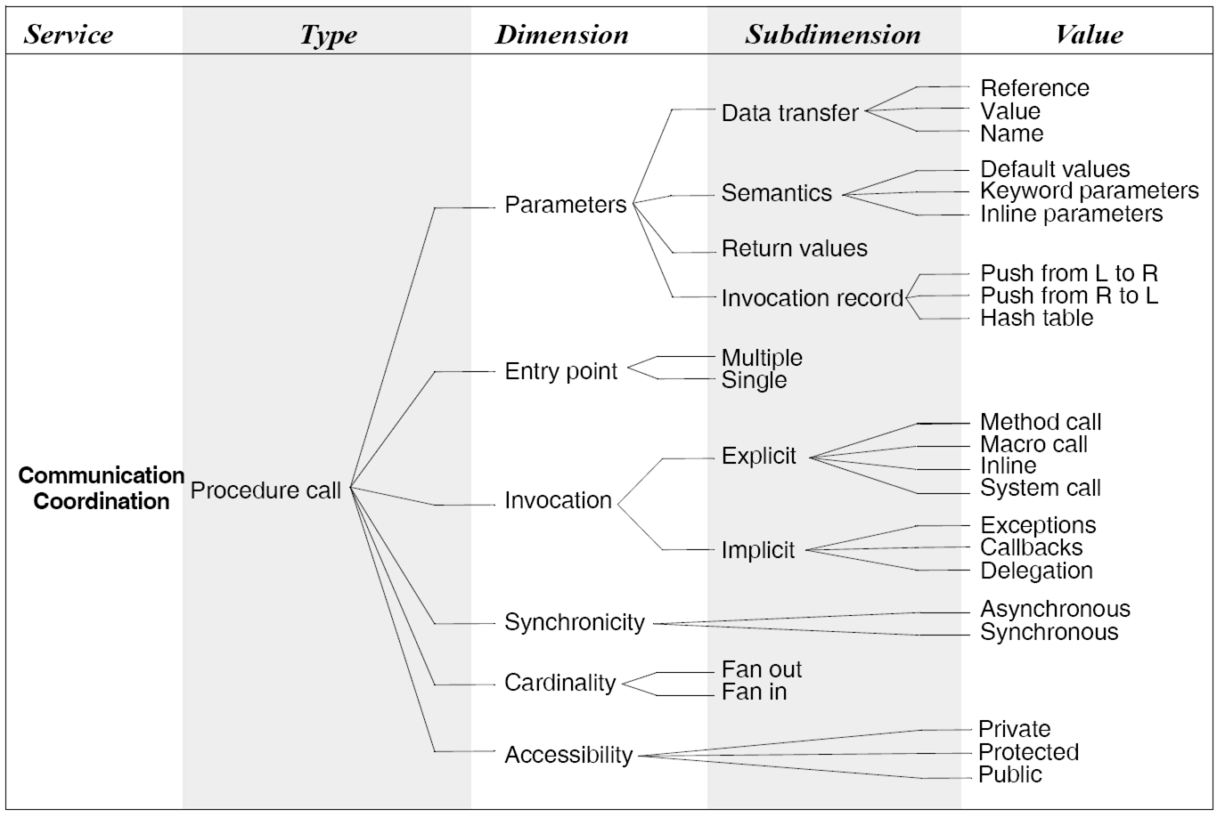
Procedure Call Connectors Revisited
Software Architecture: Foundations, Theory, and Practice; Richard N. Taylor, Nenad Medvidovic, and Eric M. Dashofy; © 2008 John Wiley & Sons, Inc. Reprinted with permission.

Slide 7
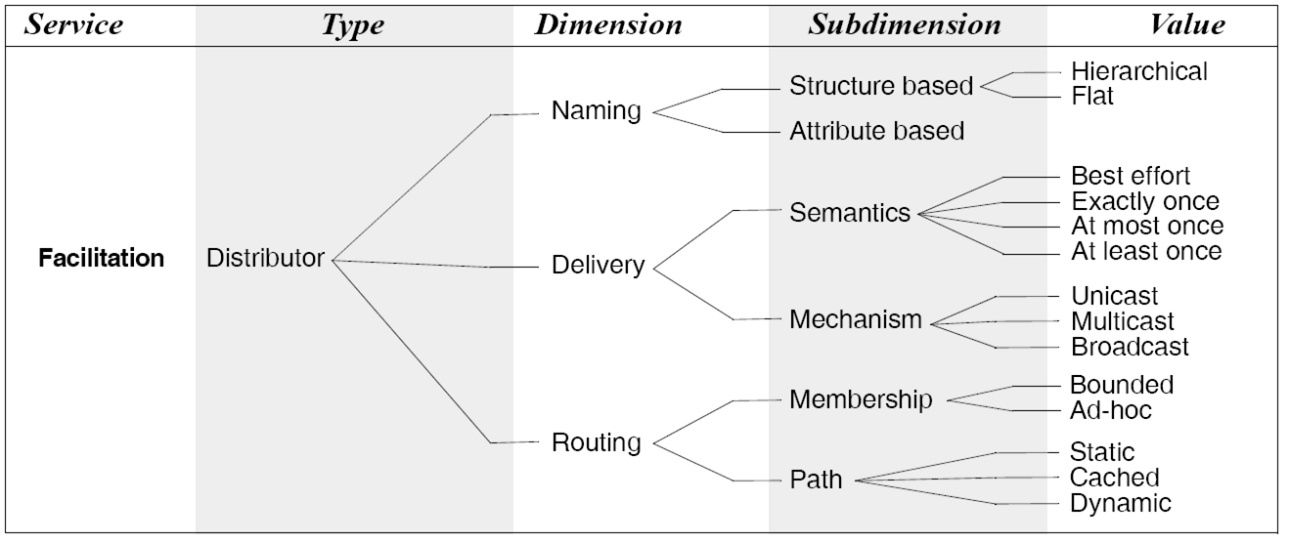
Distributor Connectors Revisited
Software Architecture: Foundations, Theory, and Practice; Richard N. Taylor, Nenad Medvidovic, and Eric M. Dashofy; © 2008 John Wiley & Sons, Inc. Reprinted with permission.

Slide 8
Two Connector Types in Tandem
Select the appropriate
values for PC and RPC!
Software Architecture: Foundations, Theory, and Practice; Richard N. Taylor, Nenad Medvidovic, and Eric M. Dashofy; © 2008 John Wiley & Sons, Inc. Reprinted with permission.

Slide 9
Software Interconnection Models
Interconnection models (IM) as defined by Perry
  Unit interconnection
  Syntactic interconnection
  Semantic interconnection
All three are present in each system
Are all equally appropriate at architectural level?

Slide 10
Unit Interconnection
Defines relations between system’s units
  Units are components (modules or files)
  Basic unit relationship is dependency
    Unit-IM = ({units},{“depends on”})
Examples
  Determining context of compilation
    e.g., C preprocessor
    IM = ({files},{“include”})
  Determining recompilation strategies
    e.g., Make facility
    IM = ({compile_units},{“depends on”,“has changed”})
  System modeling
    e.g., RCS, DVS, SVS, SCCS
    IM = ({systems, files},{“is composed of”})

Slide 11
Unit Interconnection Characteristics
Coarse-grain interconnections
  At level of entire components
Interconnections are static
Does not describe component interactions
  Focus is exclusively on dependencies

Slide 12
Syntactic Interconnection
Describes relations among syntactic elements of programming languages
  Variable definition/use
  Method definition/invocation
    IM = ( {methods, types, variables, locations},
    {“is def at”, “is set at”, “is used at”,
    “is del from”, “is changed to”, “is added to”})
Examples
  Automated software change management
    e.g., Interlisp’s masterscope
  Static analysis
    e.g., Detection of unreachable code by compilers
  Smart recompilation
    Changes inside unit ➔ recompilation of only the changes
  System modeling
    Finer level of granularity than unit-IM

Slide 13
Syntactic Interconnection Characteristics
Finer-grain interconnections
  At level of individual syntactic objects
Interconnections are static & dynamic
Incomplete interconnection specification
  Valid syntactic interconnections may not be allowed by semantics
  Operation ordering, communication transactions
    e.g., Pop on an empty stack
  Violation of (intended) operation semantics
    e.g., Trying to use calendar add operation to add integers

Slide 14
Semantic Interconnection
Expresses how system components are meant to be used
  Component designers’ intentions
Captures how system components are actually used
  Component users’ (i.e., system builders’) intention
Interconnection semantics can be formally specified
  Pre- & post-conditions
  Dynamic interaction protocols (e.g. CSP, FSM)
    IM = ({methods, types, variables, ..., predicates},
    {“is set at”, “is used at”, “calls”, “called by”,
    ..., “satisfies”})

Slide 15
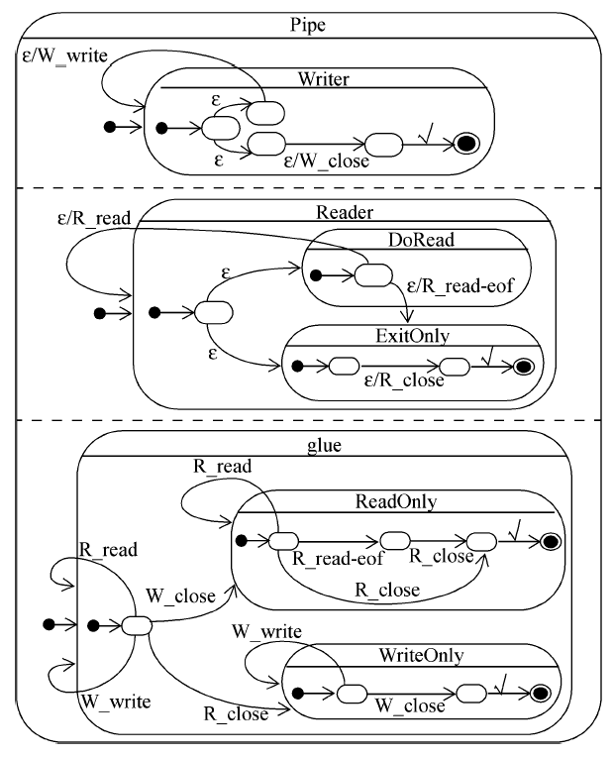
Example of Semantic Interconnection
connector Pipe =
role Writer = write → Writer П close → ✓
role Reader =
let ExitOnly = close → ✓
in let DoRead = (read → Reader
 read-eof → ExitOnly)
in DoRead П ExitOnly
glue = let ReadOnly = Reader.read → ReadOnly
 Reader.read-eof
→ Reader.close → ✓
 Reader.close → ✓
in let WriteOnly = Writer.write → WriteOnly
 Writer.close → ✓
in Writer.write → glue
 Reader.read → glue
 Writer.close → ReadOnly
 Reader.close → WriteOnly
Software Architecture: Foundations, Theory, and Practice; Richard N. Taylor, Nenad Medvidovic, and Eric M. Dashofy; © 2008 John Wiley & Sons, Inc. Reprinted with permission.

Slide 16
Semantic Interconnection Characteristics
Builds on syntactic interconnections
Interconnections are static & dynamic
Complete interconnection specification
  Specifies both syntactic & semantic interconnection validity
Necessary at level of architectures
  Large components
  Complex interactions
  Heterogeneity
  Component reuse
What about ensuring other properties of interaction?
  Robustness, reliability, security, availability, ...

Slide 17
Composing Basic Connectors
In many systems a connector of multiple types may be required to service (a subset of) the components
All connectors cannot be composed
  Some are naturally interoperable
  Some are incompatible
  All are likely to require trade-offs
The composition can be considered at the level of connector type dimensions and subdimensions

Slide 18




Connector Dimension Inter-Relationships
Requires –
  Choice of one dimension mandates the choice of another
Prohibits –
  Two dimensions can never be composed into a single connector
Restricts –
  Dimensions are not always required to be used together
  Certain dimension combinations may be invalid
Cautions –
  Combinations may result in unstable or unreliable connectors

Slide 19
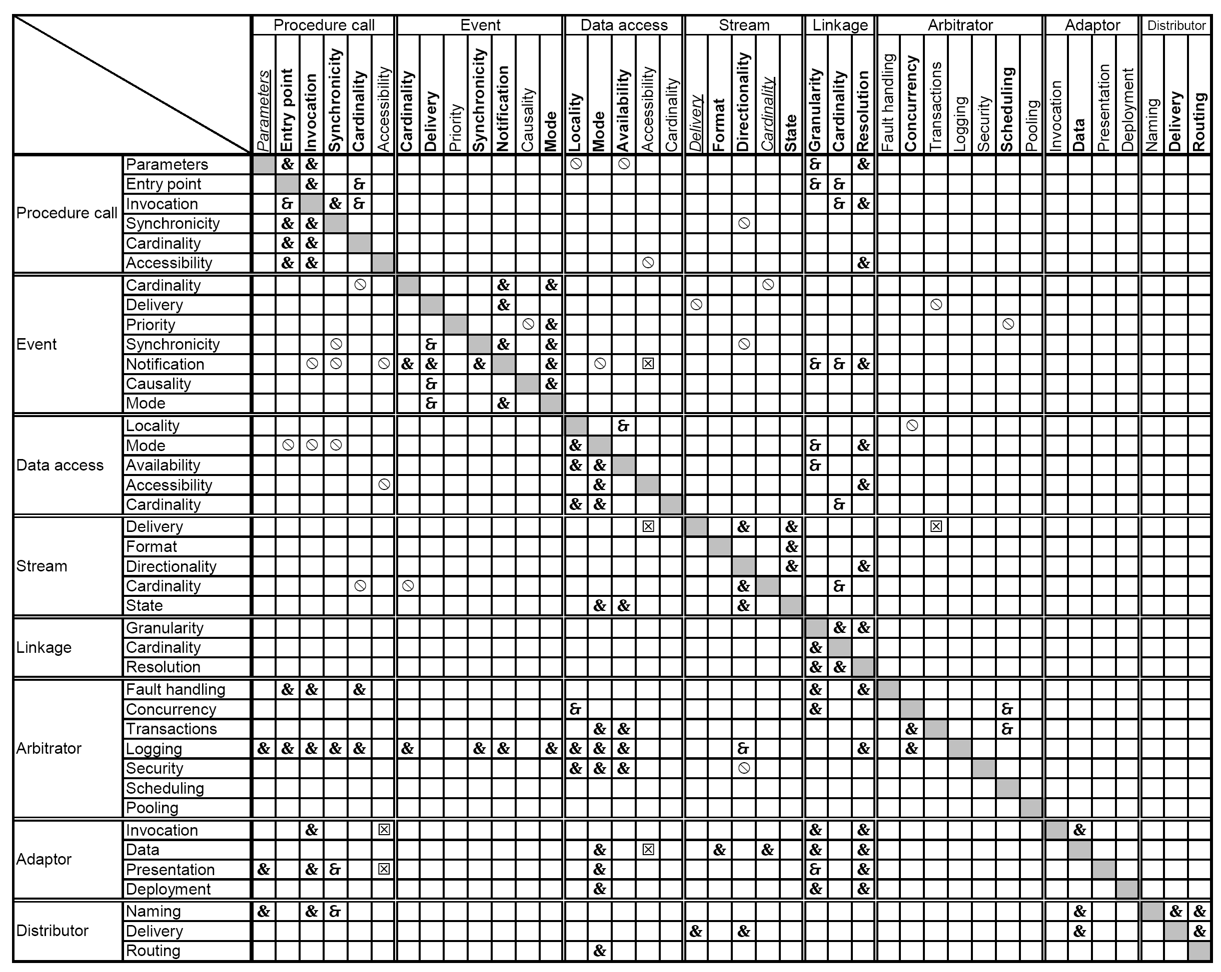
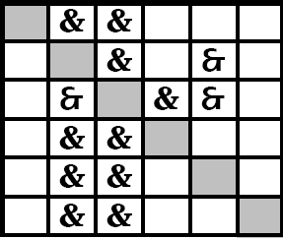
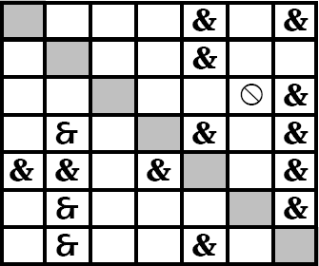
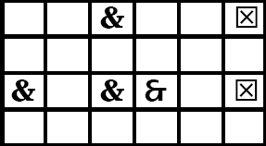
Dimension Inter-Relationships
Software Architecture: Foundations, Theory, and Practice; Richard N. Taylor, Nenad Medvidovic, and Eric M. Dashofy; © 2008 John Wiley & Sons, Inc. Reprinted with permission.

Slide 20
Well Known Composite Connectors
Grid connectors (e.g., Globus)
  Procedure call
  Data access
  Stream
  Distributor
Peer-to-peer connectors (e.g., Bittorrent)
  Arbitrator
  Data access
  Stream
  Distributor
Client-server connectors
Event-based connectors

